Slide 1


Digital Health
UCSD Extension – Specialization Certificate
Data Science for Healthcare
L2: Statistics
Hobson Lane, UC San Diego
Instructor
Notes:
<number>

Slide 2
Syllabus
Lesson | Title | Topics
1 | Data Science for Digital Health | applications, terminology, HIPPA
2 | Spreadsheet Data Science | ETL, exploration & visualization
3 | Statistics, Privacy, Ethics | causality, correlation, MLE
4 | Clinical Data Science & ML | PII, prescriptive vs descriptive
5 | Deep Learning & AI | neural nets, radiology, CV
6 | Hospital Performance Modeling | time series, unintended conseq.
7 | Population Health & Epi | GIS, spatio-temporal modeling
8 | Healthcare Public Policy | scoping review, gap analysis of diabetes
9 | Natural Language Processing | IA, summarization, text mining
10 | Bioinformatics | DNA, RNA, proteins, algorithms
Project | Train a healthcare ML model | find/download data, ETL,

Slide 3
Agenda

Slide 4
What is statistics? How is statistics used in healthcare?

Slide 5
Probability

Slide 6
Conditional Probability

Slide 7
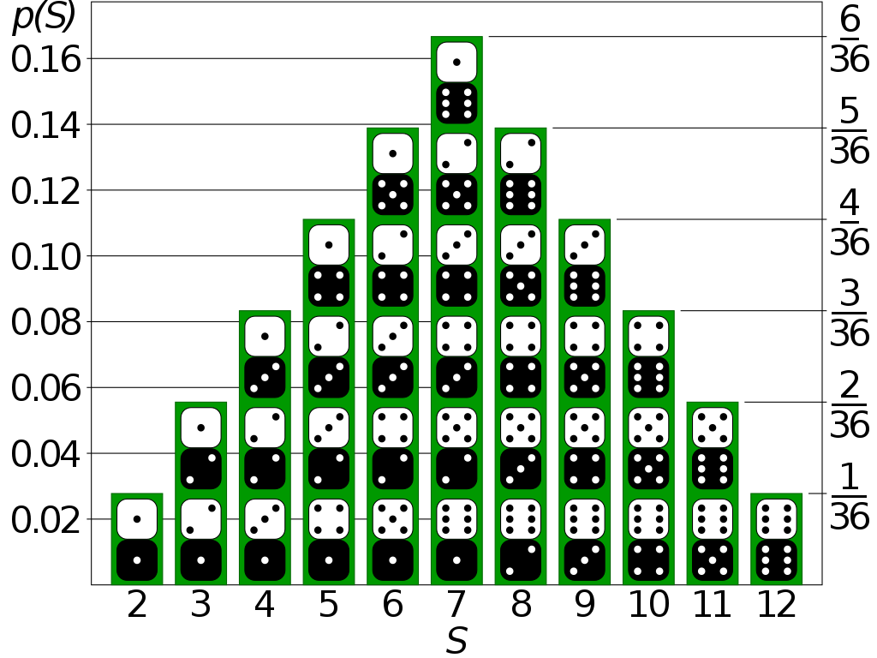
Probability Distribution
Text files (CSV, TSV, JSON, TXT)
Compressed files (ZIP, GZ)
Binary files (XLS, PDF, Images)
Web pages (links to HTML)
Databases

Slide 8
Probability Distribution

Slide 9
PMF: Probability Mass Function (Discrete PDF)

Slide 10
PDF: Probability Density Function

Slide 11
Continuous Probability Distribution

Slide 12
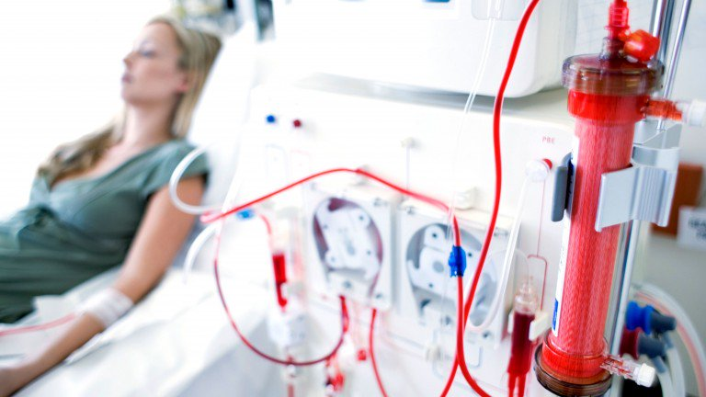
Ethics and Accuracy
Clinical records can predict Kidney failure
2 days in advance
55% accuracy for acute problems
90% accuracy for serious issues
Dataset:
100% UK citizens
100% military
90% male
DeepMind (London)

Slide 13
Berkson’s Paradox
 | General Population |  |  |  | Hospitalization past 6 mo
 | Bone Disease | No Bone Disease | % Bone Disease |  | Bone Disease | No Bone Disease | % Bone Disease
Lung disease | 17 | 207 | 7.6% |  | 5 | 15 | 25.0%
No lung disease | 184 | 2,376 | 7.2% |  | 18 | 219 | 7.6%

Slide 14
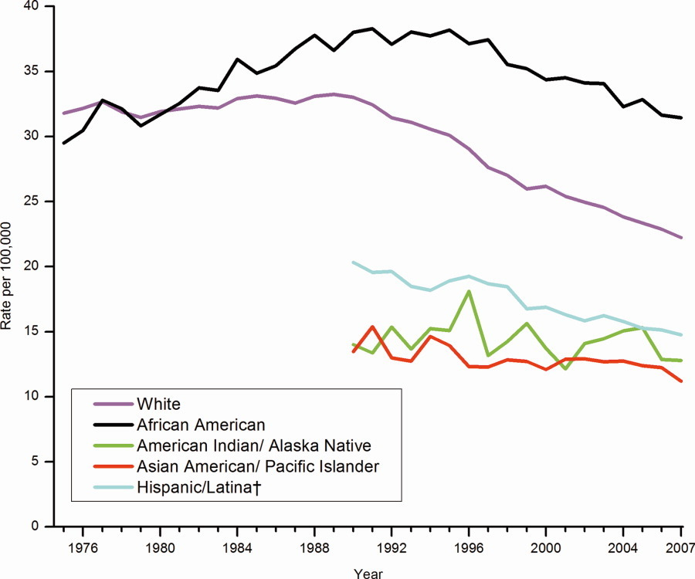
Correlation enables prediction
Breast Cancer Rates 2011: bit.ly/ucsdbreast

Slide 15
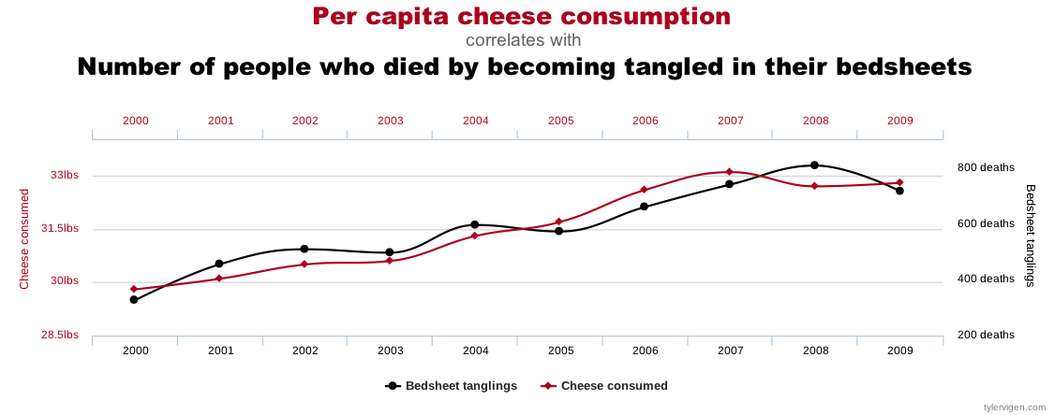
Correlation is not enough
Computers are good at finding patterns
But often those patterns are “spurious correlation”

Slide 16
Bayes Rule
Updated Probability = Likelihood Ratio x Prior Probability
$P\left(D∨T\right)=\frac{P\left(T∨D\right)}{P\left(T\right)}×P\left(D\right)$

Slide 17
Bayes Rule Example
Prior | P(D) | Probability of getting breast cancer | 1 in 700 per yr 1 in 70,000 (men)
Sensitivity | P(T|D) | Probability of mammogram detecting cancer | .73
False Positive Rate (False Alarm) | P(T|~D) | Probability of positive mammogram w/o cancer | .12
 | P(T) = P(D) * P(T|D) + P(~D) * P(T|~D) | Probability of a positive mammogram among all women | .73 * 1 / 700 + .27 * 699 / 700 = .121

Slide 18
Mammograms can cause harm!
P(D) | 1/700
P(T|D) | .73
P(T) | .121
ACP: biannually after age 50+
previously: annual exams at 40+
$P\left(D∨T\right)=\frac{P\left(T∨D\right)}{P\left(T\right)}×P\left(D\right)$
$P\left(D∨T\right)=\frac{.73}{.121}×\frac{1}{700}=.0086≈1\text{\%}$

Slide 19
Assignments

Slide 20
Quiz
Why is understanding Baye’s Rule so important?
Notes:
<number>

Slide 21
Homework: Create diabetes MLE
Download diabetes dataset: http://totalgood.org/midata/...
Notes:
<number>

Slide 22
Project
Use numpy.random.randint() to simulated rolling a pair of dice.
Notes:
<number>

